Slide 1
HF Coax Baluns
WA4AQV
N8KH

Slide 2
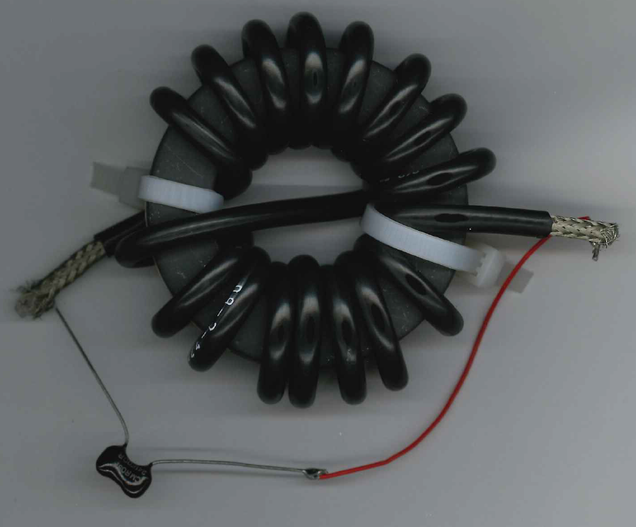
HF Choke Balun (A Coax Winding)

Slide 3
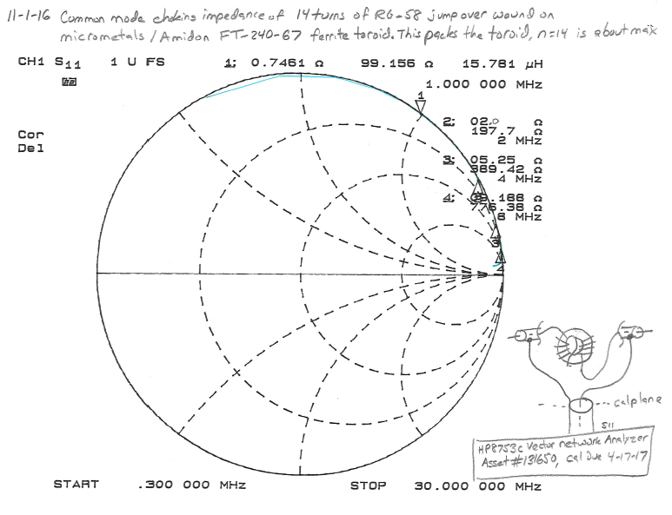
HF Choke Balun (A Coax Winding)

Slide 4
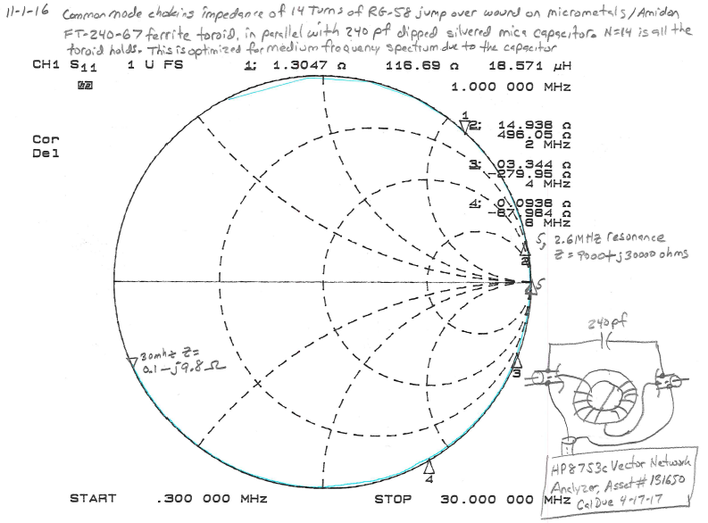
HF Choke Balun (A Coax Winding)

Slide 5
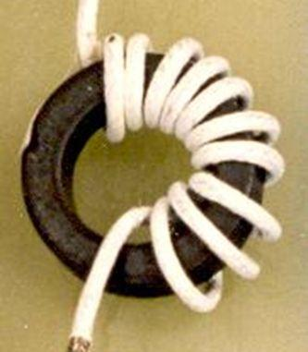

Balun Humor
Take Me To Your Leader
Sure, Follow Me To Harris!

Slide 6
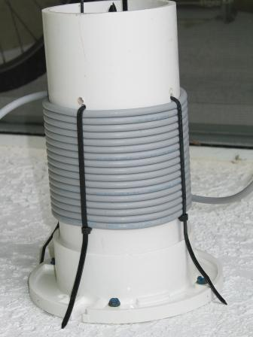
Coax Solenoid Choke Balun
PVC Form
4.5”
RG-58 Coax
Credit: Data Courtesy Of Ken Hendrickson N8KH. Picture courtesy Jim Tonte KC7SSWW

Slide 7
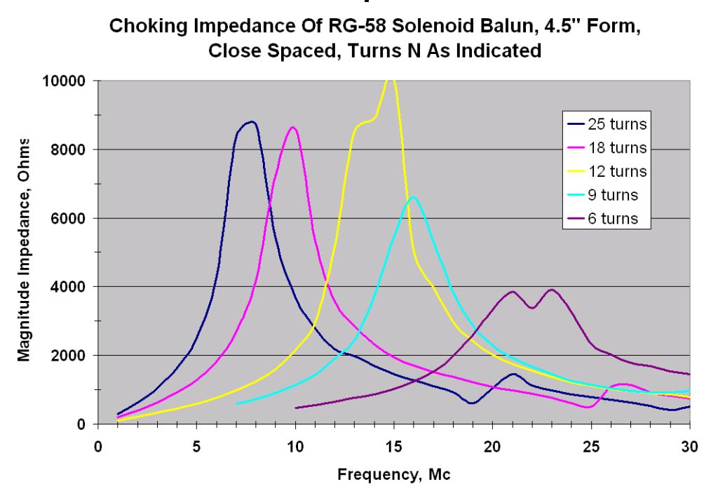
Coax Solenoid Choke Balun
Credit: Data Courtesy Of Ken Hendrickson, N8KH

Slide 8
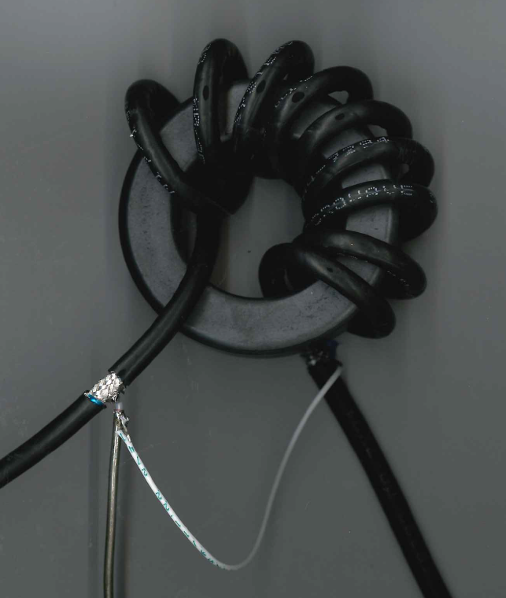
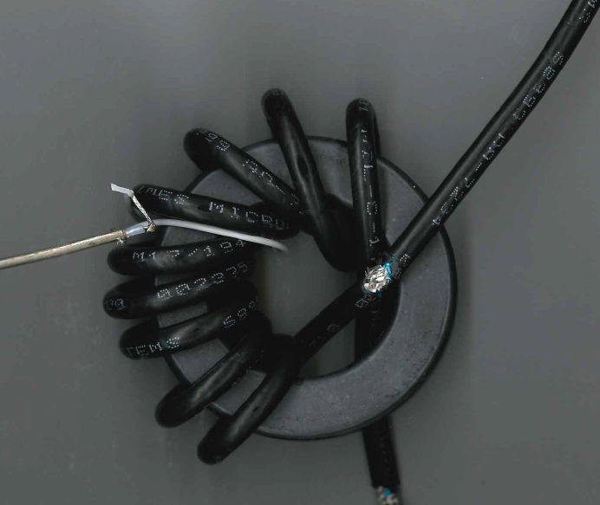
Toroidal Coax Winding Balun
1 turn transformer primary sniffing winding
Impedance from shield to shield
9 turns RG-58 on Fair Rite FT-240-43 core..

Slide 9
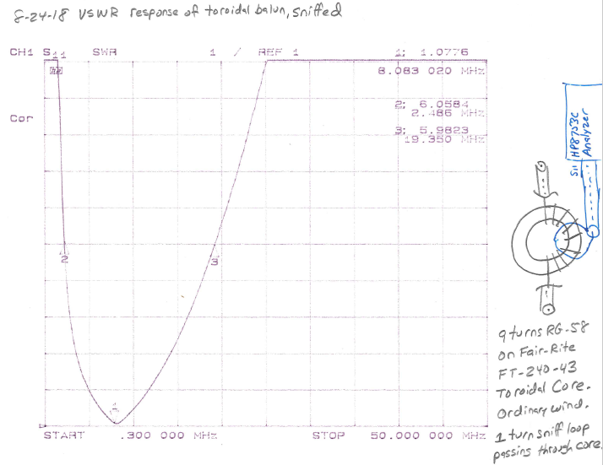
Toroidal Coax Winding Balun
Resonance at 8.08 MHz

Slide 10
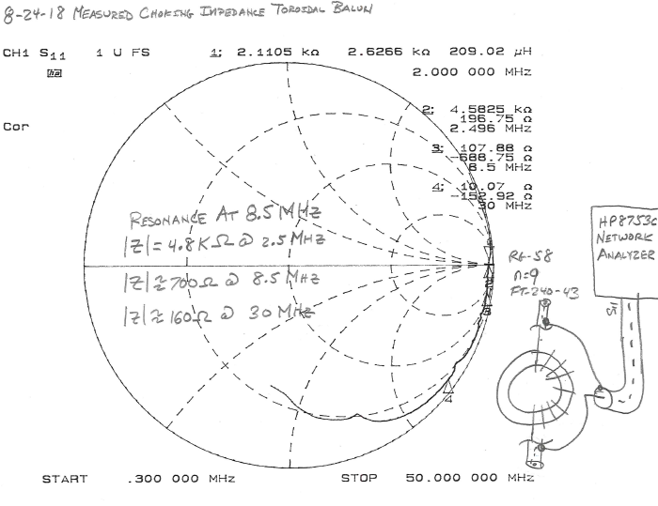
Toroidal Coax Winding Balun

Slide 11
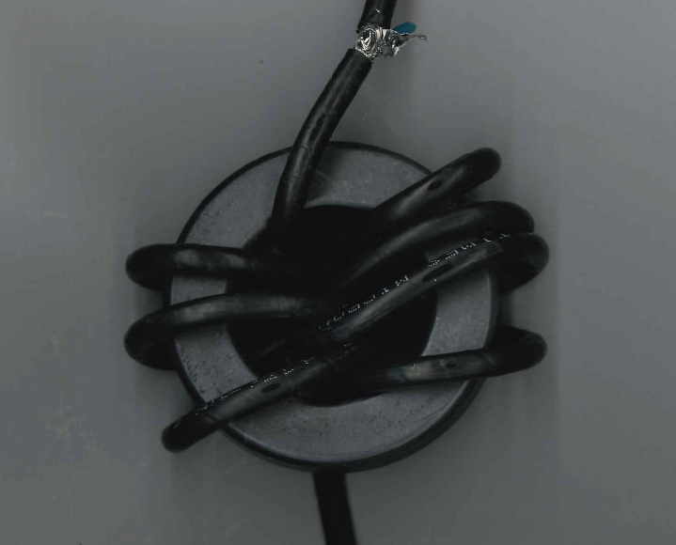
Toroidal Coax Serpentine Winding Balun

Slide 12
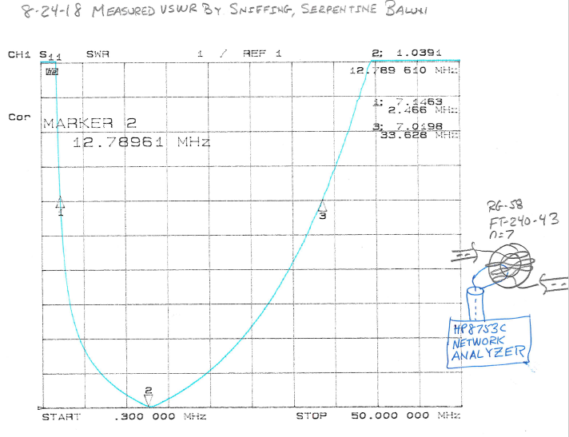
Toroidal Coax Serpentine Winding Balun

Slide 13
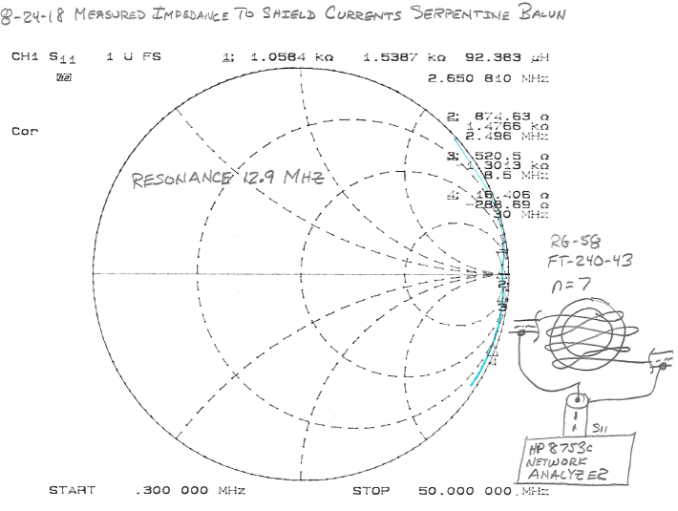
Toroidal Coax Serpentine Winding Balun

Slide 14
Toroidal Coax Conventional And Serpentine Winding Baluns Compared
Serpentine winding has more bandwidth. More ohms over more megahertz.

Slide 15
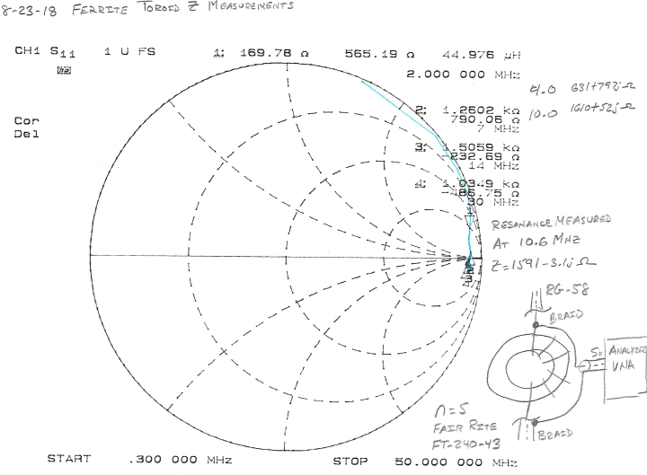
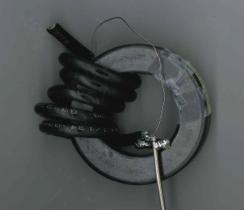
n = 5 Ferrite Toroidal Balun

